Slide 1

Explainable Ensemble of Multi-View Deep Learning Models for Used Car Price Prediction
This project develops an advanced system to predict used car prices in India, addressing challenges like market fraud and pricing bias. Leveraging machine learning and deep learning techniques, the model ensures accurate, unbiased valuations to foster transparency for buyers and sellers. The solution integrates a user-friendly Django web interface for real-time price prediction, using a comprehensive dataset with features such as car age, mileage, fuel type, and ownership history.

Slide 2

Project Motivation and Problem Definition
Motivation
Problem Definition
Rising costs and limited availability of new cars in India push buyers towards the used car market, which is largely unorganized and prone to fraudulent pricing. This creates a need for accurate, unbiased price prediction models to ensure fair transactions.
Challenges include eliminating pricing bias, handling sparse data for very new or old cars, preprocessing complex datasets, and incorporating multiple factors like mileage and ownership history to produce reliable price estimates.

Slide 3
Literature Review: Insights from Prior Research
Neural Network Models
Regression and Ensemble Methods
Data Preprocessing Importance
Automation and Fair Pricing
Backpropagation Neural Networks with optimization techniques improve price prediction accuracy and training efficiency, supporting scalable pricing systems.
Combining regression algorithms like Random Forest and Gradient Boosting enhances prediction accuracy but increases computational complexity.
Quantifying qualitative data and removing outliers significantly improve model performance, emphasizing the need for domain expertise in feature selection.
Integration of Robotic Process Automation for data extraction and supervised learning models helps reduce pricing disparities and fraud risks.

Slide 4

Proposed Model and System Design
Hybrid Approach
System Workflow
Combines Artificial Neural Networks (ANN) for non-linear patterns, Random Forest for robust decisions, and regularized linear models (Lasso, Ridge) for multicollinearity handling.
Includes data preprocessing, feature engineering, model training with early stopping, and deployment via Django web framework for real-time predictions.
Benefits
High accuracy with reduced bias, scalable modular design, user-friendly interface, and adaptability for future electric vehicle pricing.

Slide 5




Implementation: Dataset and Model Training
Dataset Collection
Used Kaggle’s CarDekho dataset containing features like brand, year, selling price, mileage, fuel type, seller type, transmission, and ownership history.
Data Preprocessing
Removed underrepresented CNG cars, encoded categorical variables, eliminated outliers using IQR, and scaled features for model compatibility.
Model Training
Configured a deep neural network with 10,000 epochs and batch size 20, monitored loss reduction indicating effective learning and convergence.

Slide 6
Model Evaluation and Performance Metrics
Mean Absolute Error (MAE)
R-Squared (R²) Score
Measures average absolute difference between predicted and actual prices; lower values indicate better accuracy.
Indicates proportion of variance explained by the model; values closer to 1 represent better fit.
The model achieved an MAE of 1.097 and R² of 0.772, demonstrating reliable price prediction capabilities.

Slide 7
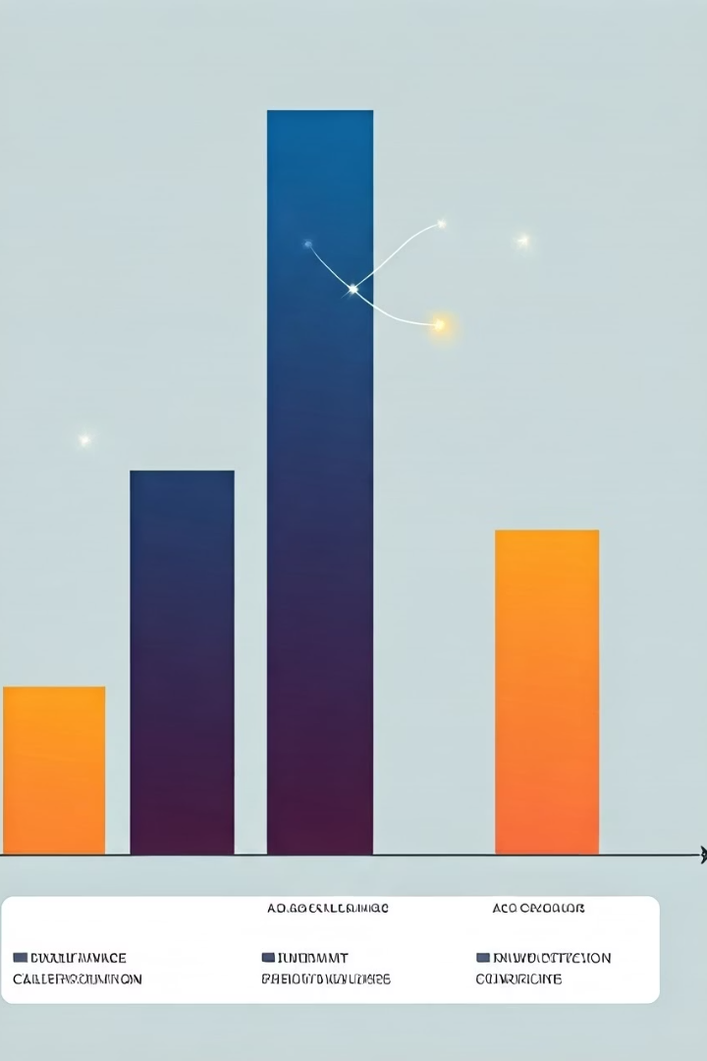
Result Analysis: Comparing Algorithms
Algorithm
MAE
R² Score
Random Forest Regressor
0.7462
0.9170
Deep Neural Network (10 layers)
0.7660
0.8421
Lasso Regression
1.0507
0.8709
Linear Regression
1.1516
0.8366
Random Forest outperforms other models with the lowest error and highest variance explanation, while deep neural networks offer competitive results with scalability.

Slide 8
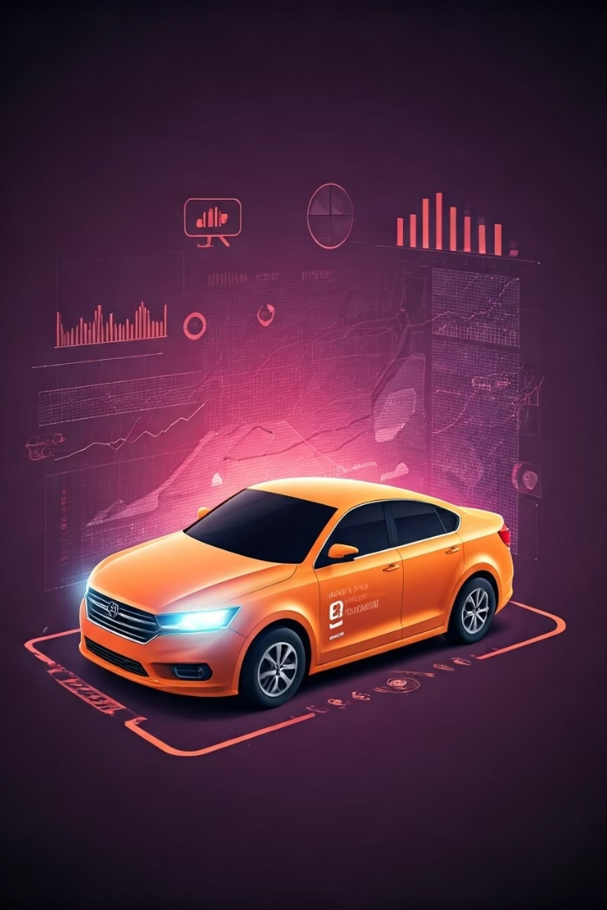
Conclusion and Future Enhancements
Conclusion
The project successfully developed a bias-free, accurate used car price prediction system using ML and DL techniques, promoting transparency and reducing fraud in India’s market.
Future Enhancements
Integrate real-time data from online platforms for dynamic pricing updates.
Train on diverse regional datasets to improve generalizability.
Incorporate temporal trends and vehicle history for personalized predictions.
Deploy via cloud APIs for scalability and accessibility.
Implement user feedback loops and reinforcement learning for continuous improvement.
Expand framework to other asset markets like motorcycles and electronics.

